Slide 1

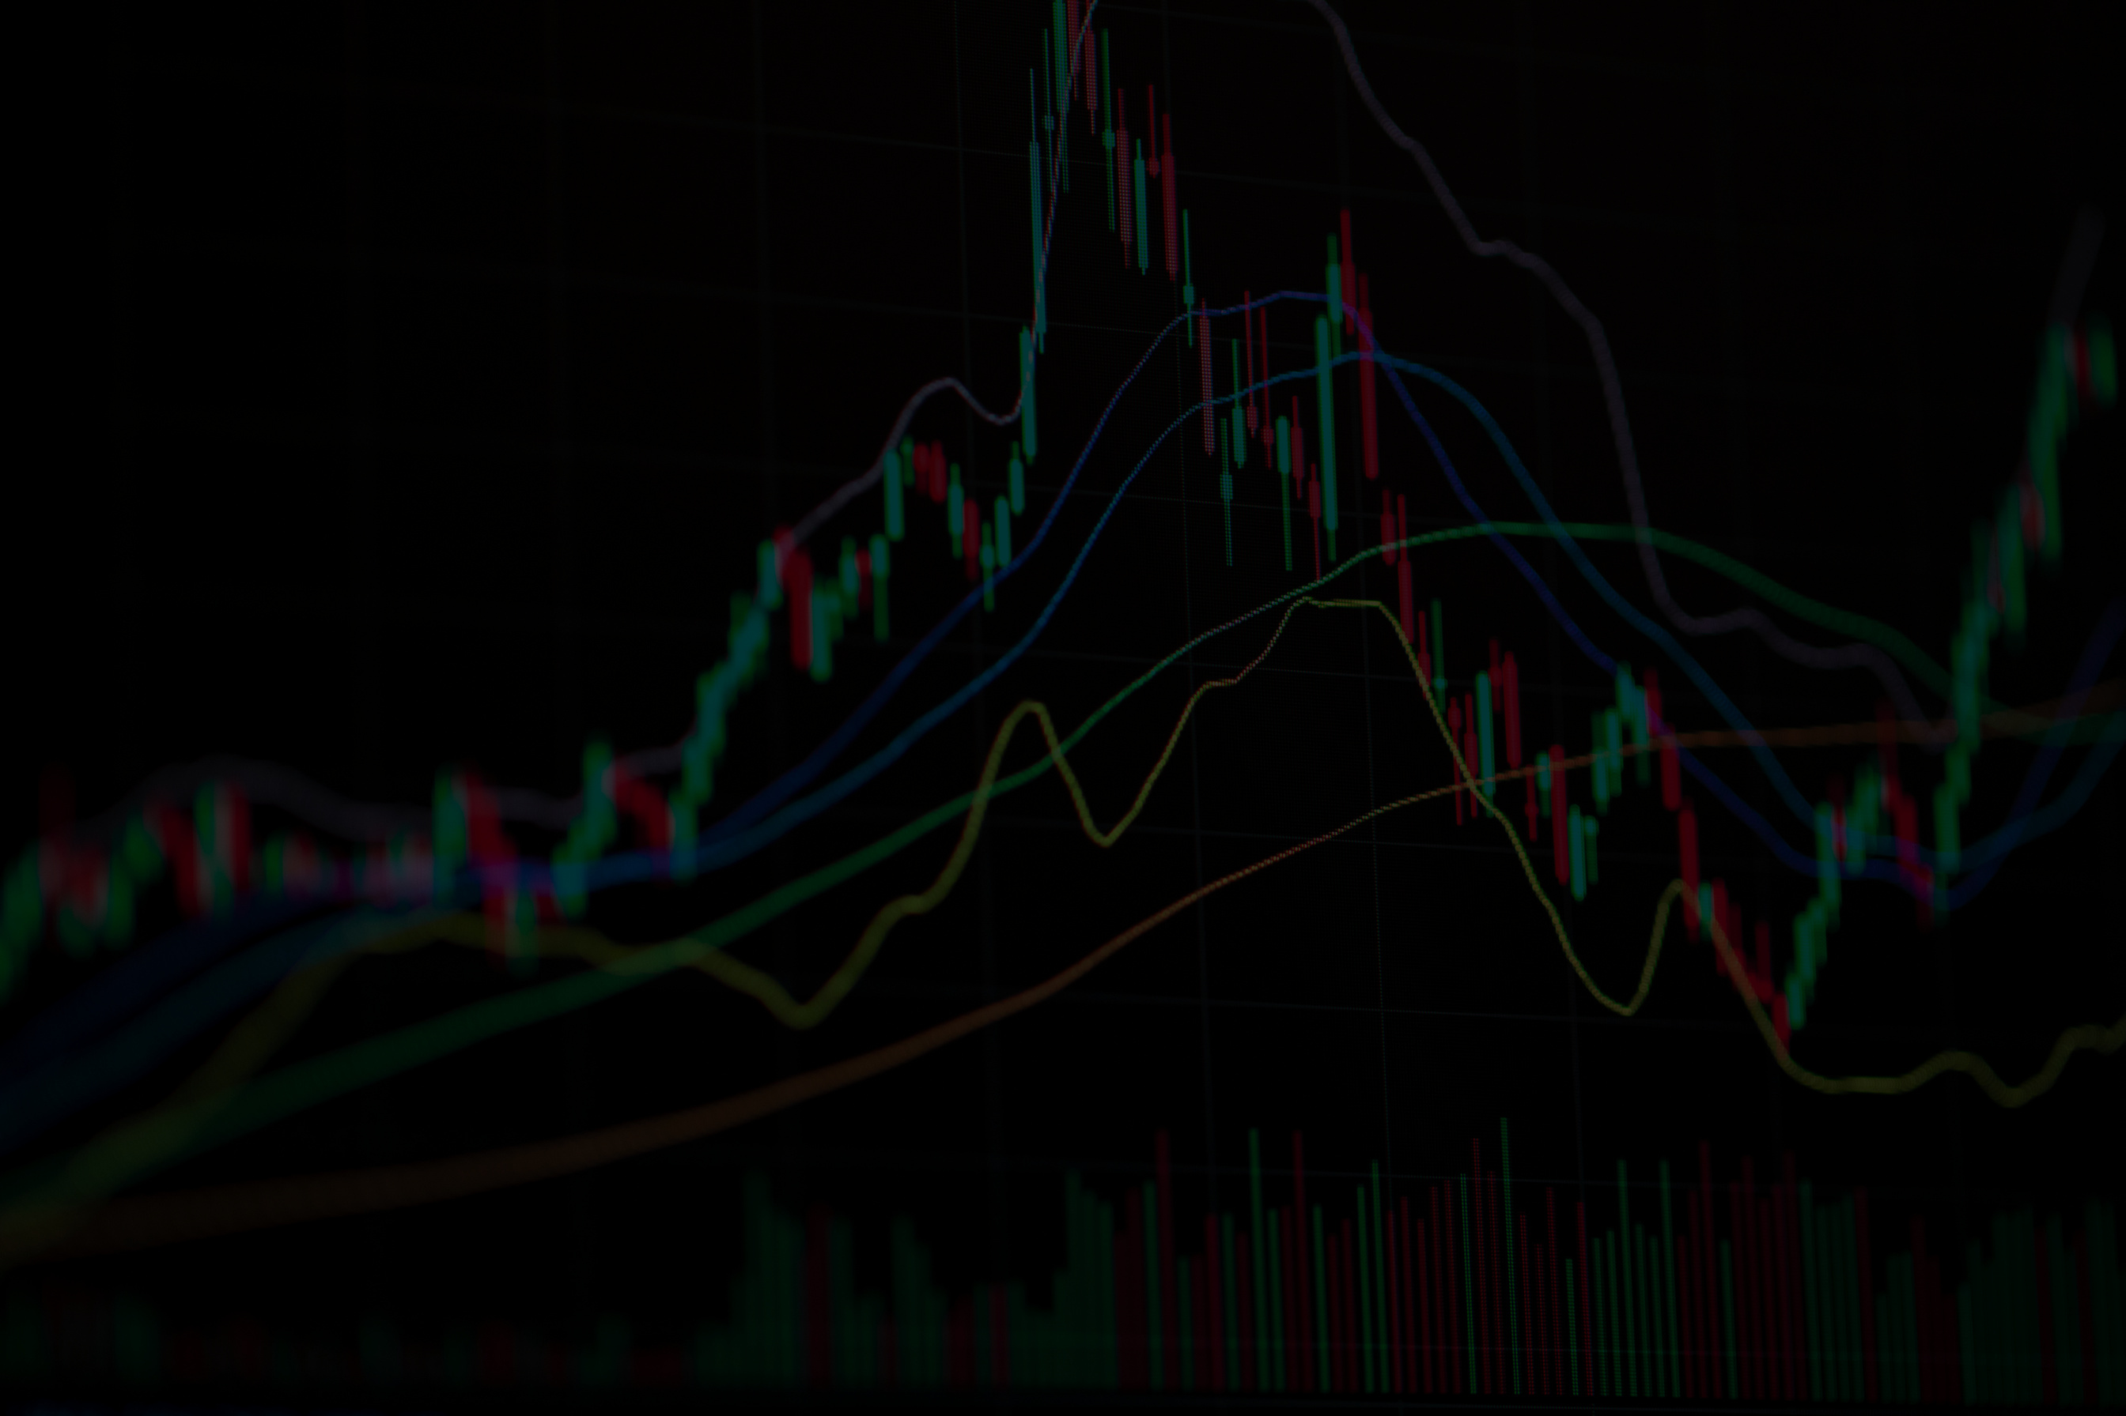

AI-POWERED STOCK AND ETF SIGNAL GENERATION PLATFORM

Slide 2
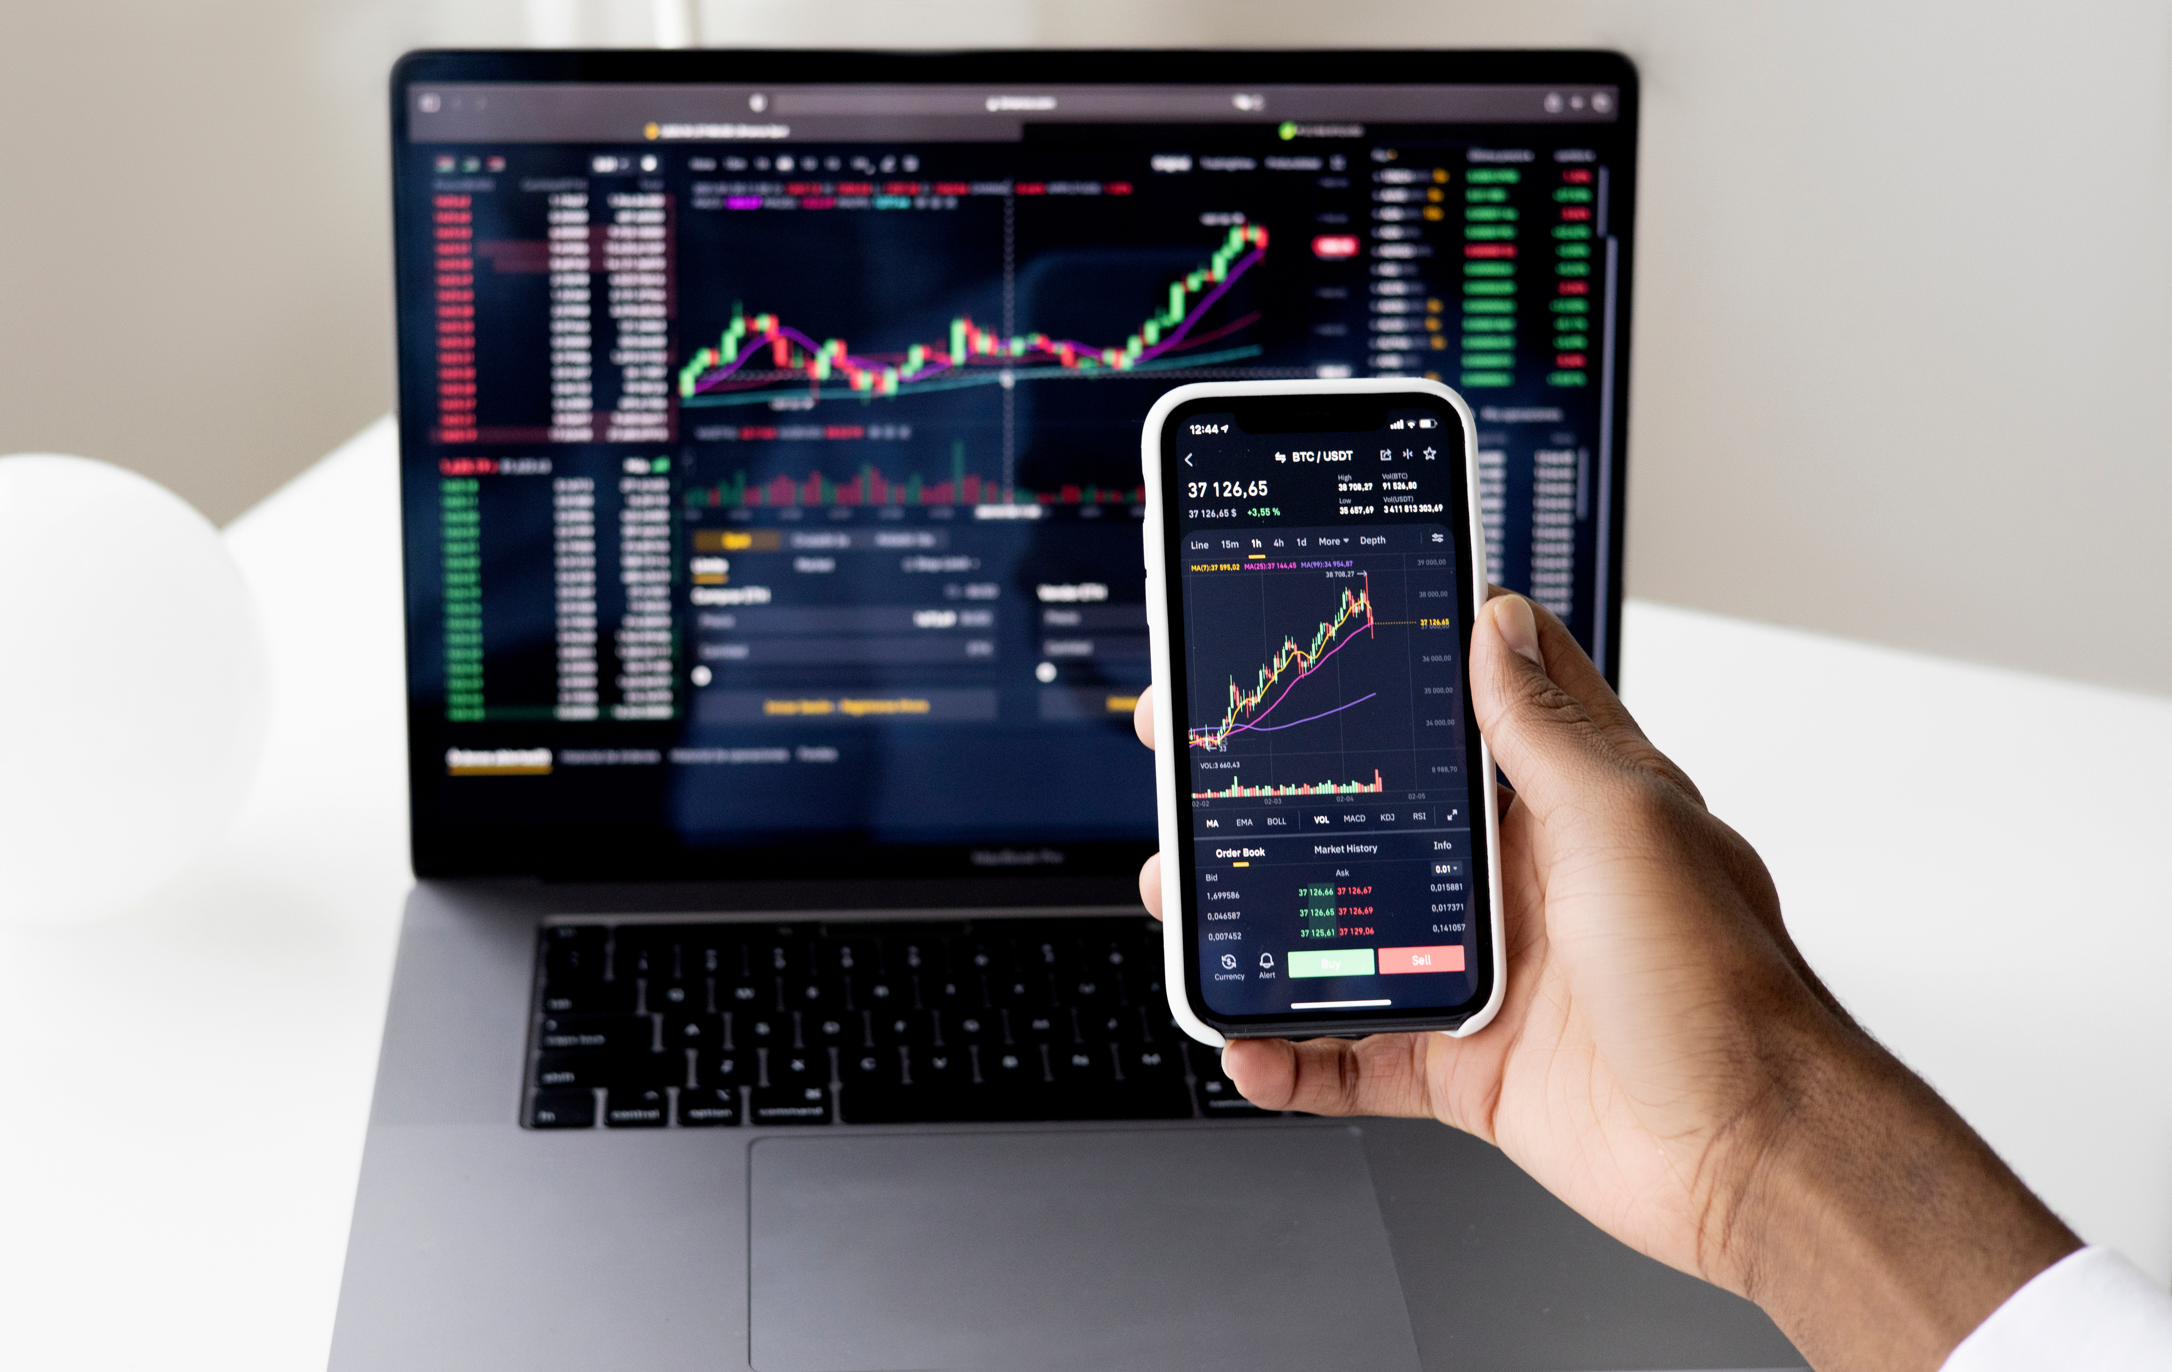







Problem Statement
The Challenge We Face
Investors and analysts face significant barriers in efficiently analyzing market data
Time-Consuming Analysis
Manual analysis of large volumes of stock and ETF data is slow and inefficient
Error-Prone Decisions
Human error in interpreting complex market indicators leads to poor trading decisions
Complex Metrics
Users struggle to interpret technical metrics and backtesting results effectively
Lack of Real-Time Response
No automated system to validate strategies and deliver timely trading alerts
Strategy Validation Gap
Difficulty in backtesting and validating trading strategies before actual deployment
No intelligent Insights
Absence of AI-driven explanations to help users understand why specific signals are generated

Slide 3


End-to-End Solution
Platform Architecture
Modular Python-based platform using FastAPI backend for scalable communication between modules
Data Ingestion
Data Pipeline
Storage
ML Models
yfinance API
Medallion Architecture
Supabase PostgreSQL
RF,XGBoost, LSTM
60+ Indian stock tickers
Bronze >> Silver >>Gold
Ticker & feature storage
Buy/Sell/Hold Signals
Backtesting
Gen AI
Alerts
Dashboard
VectorBT
LLM Explanations
Gmail/SMTP
Streamlit
5-year validation
Signal insights
Confidence-based
Visual analytics
Signal Prediction
Strategy Validation
Real-Time Alerts
ML models
Backtesting confidence
Email notifications
Python FastAPI Streamlit Supabase VectorBT yfinance GenAI Gmail SMTP

Slide 4





Data Ingestion & API Layer
Automated backend infrastructure for real-time stock market analysis with 60+ Indian stock tickers
Yahoo Finance
Data Pipeline
Supabase
FastAPI
ML APIs
Data Source
ETL Process
PostgreSQL
Dashboard
Data Pipeline Process
Fetch Data
Clean and Validate
Add Features
OHLCV from yfinance
Remove nulls and Duplicate
RSI, SMA, MACD, etc.
60+ Indian Tickers
5 Years Historical
6+ ML Features
60+ Indian Tickers
5 Years Historical
6+ ML Features
Tech Stack
Medallion Architecture
Bronze Layer: Raw OHLCV data ingestion
yfinance
Python
Supabase
Silver Layer: Cleaned and validated data
numpy
pandas
FastAPI
Gold Layer: Feature-enriched ML data

Slide 5




Data Pipeline Flowchart
Data Ingestion
Storage
API Layer
ML Pipeline
1
2
3
4
5
Fetch OHLCV data
Clean & validate data
Feature engineering (RSI, SMA, Volatility, MACD etc.)
Sync processed data to Supabase
Update available data
6
7
8
9
10
Request training data via FastAPI
Query features from database
Return data to ML models
Deliver features for prediction
Train/Predict signals
MLOps & Drift Detection Flow
Fetch Baseline
Last 30 days data
Compare Window
Last 7 days data
Calculate Z-scores
KS test p-value
Alert & Retrain
If drift detected

Slide 6
Key Engineering Highlights
Core technical decisions powering the data pipeline
Incremental Loading
Parallel Processing
Dual Persistence
Pipeline checks existing records and only fetches missing date ranges, optimizing data transfer
Uses ThreadPool Executor to process multiple tickers concurrently, reducing execution time
Data stored locally as Apache Parquet for speed and in Cloud (Supabase) for accessibility
Drift Detection
Technical Indicators
Automated Alerts
Implements Kolmogorov-Smirnov (KS) tests to monitor feature distribution shifts
RSI, SMA (20/50), Rolling Volatility, MACD, Volume MA for comprehensive ML features
If data drift detected (p-value < 0.05), system logs alert for model retraining
PostgreSQL Data Model
Stock features table with composite key (ticker, date) + B-Tree indexing

Slide 7

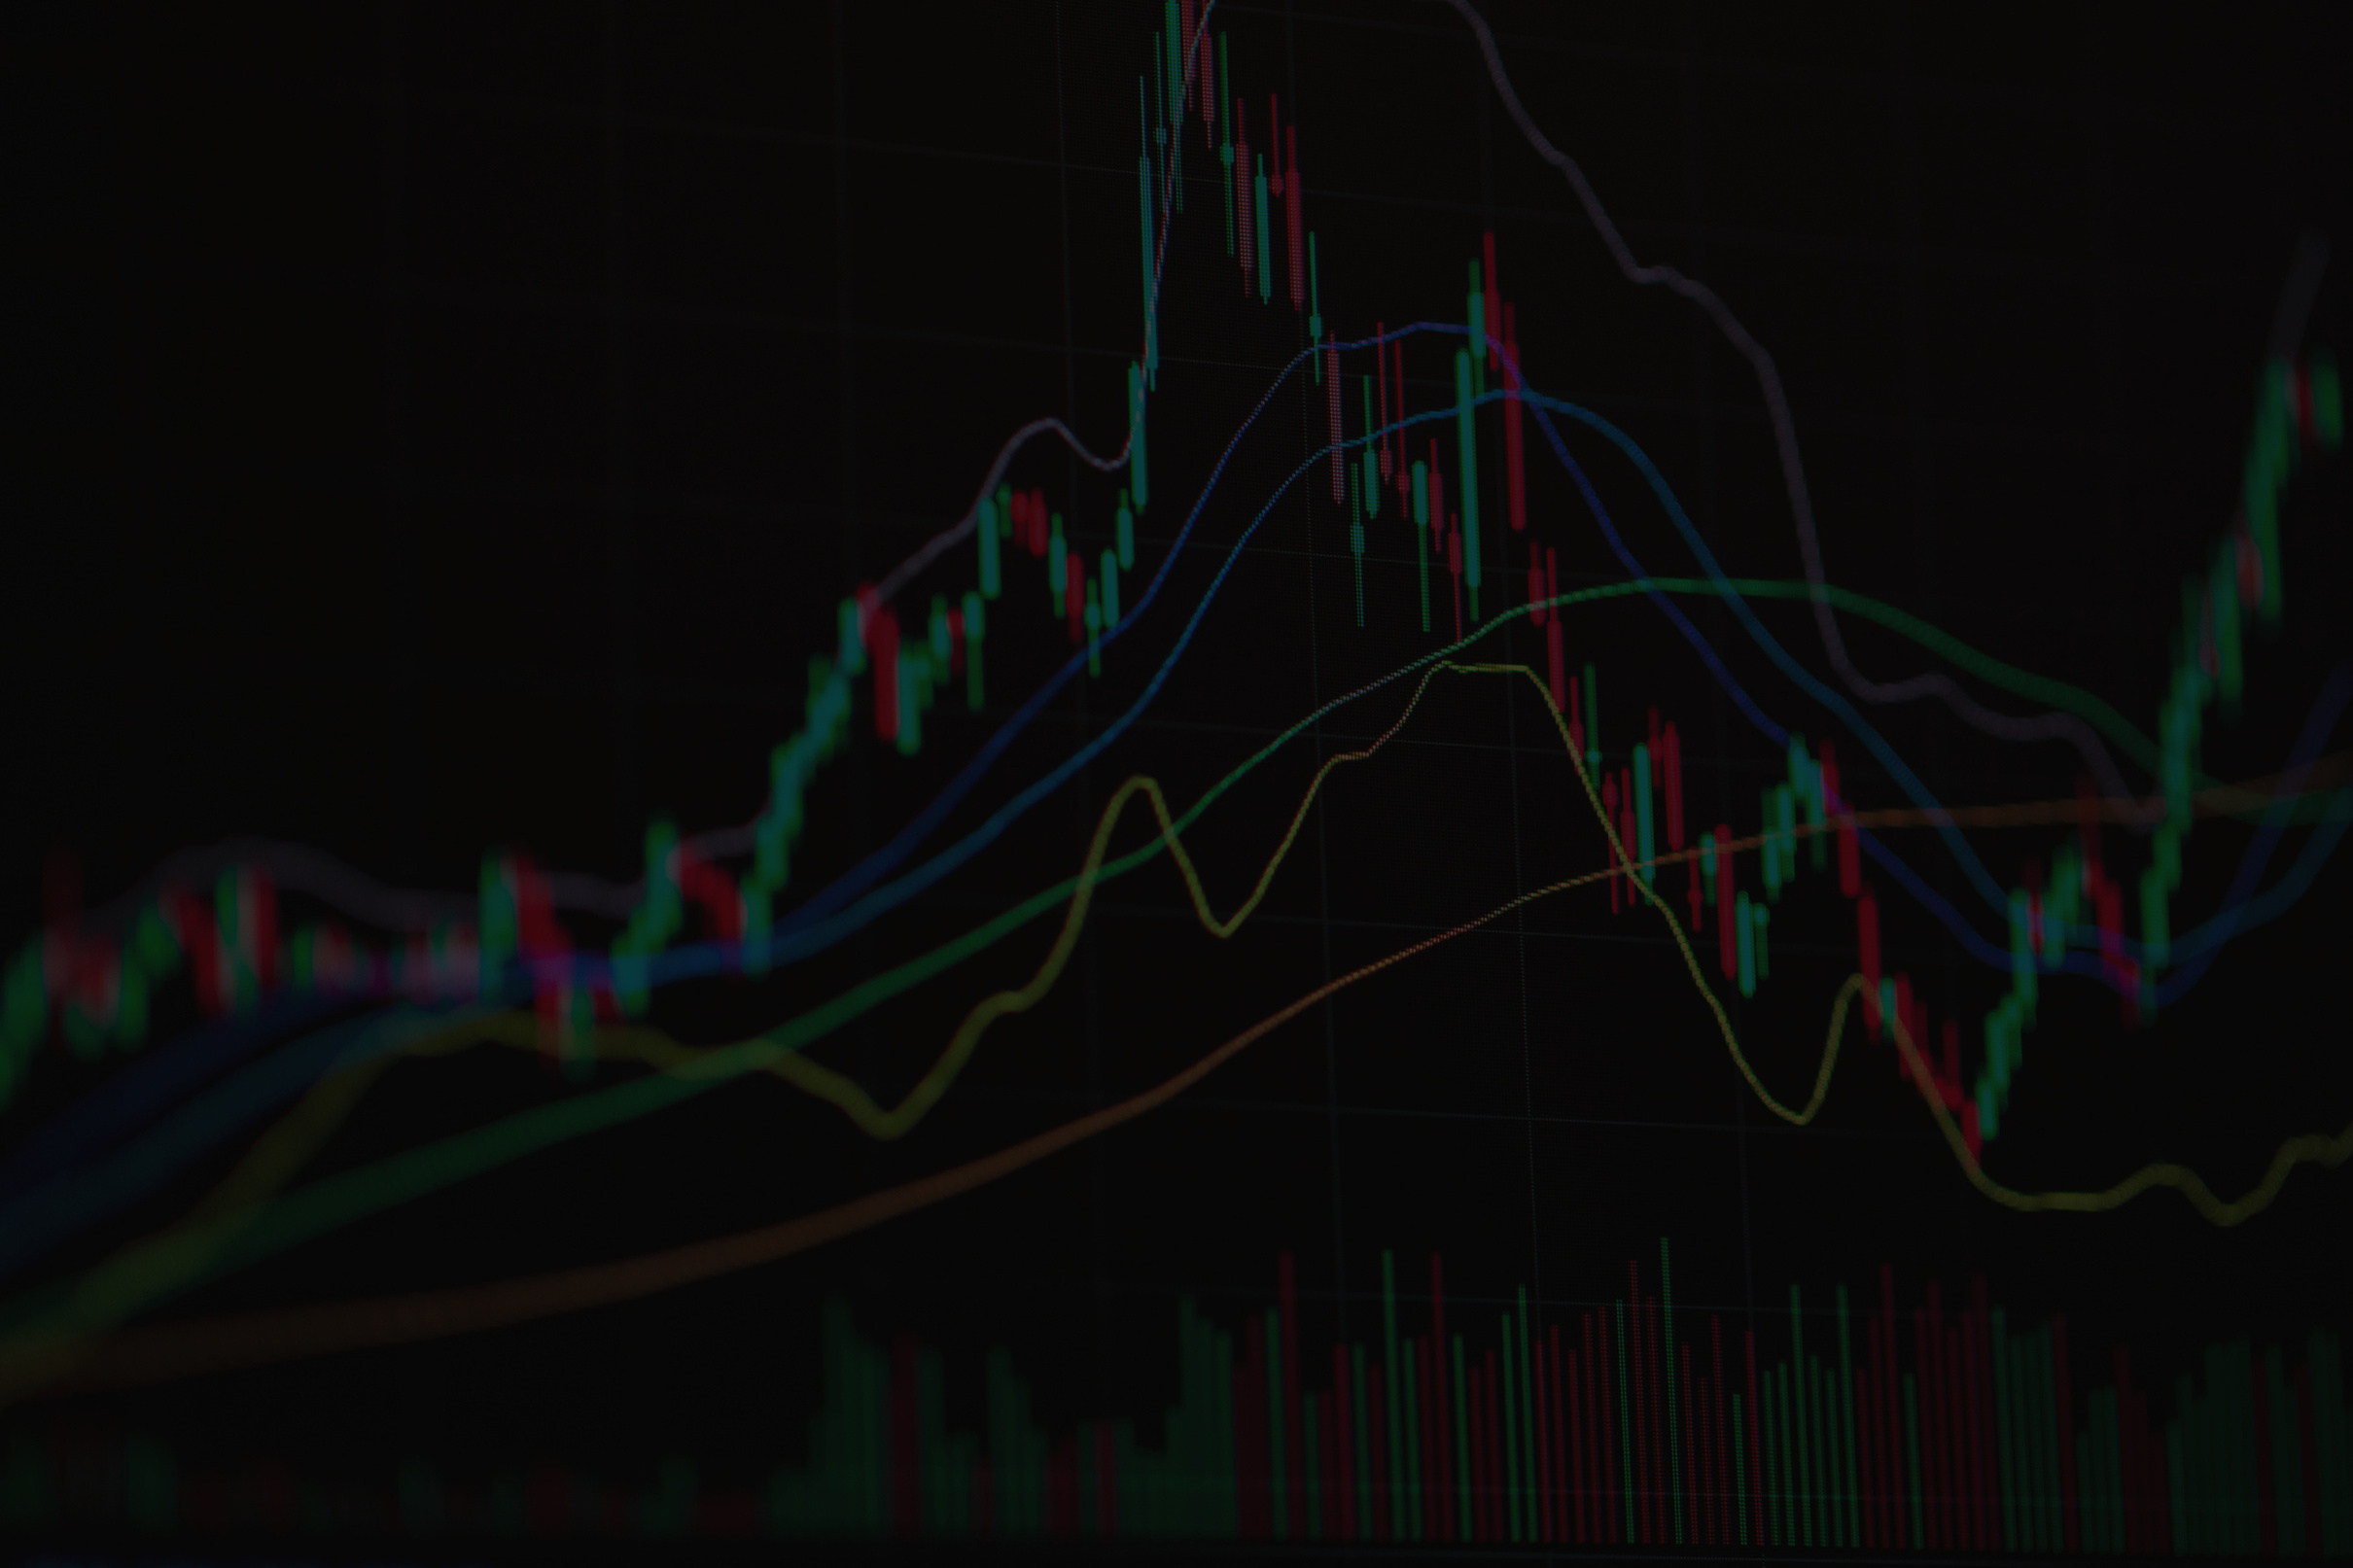

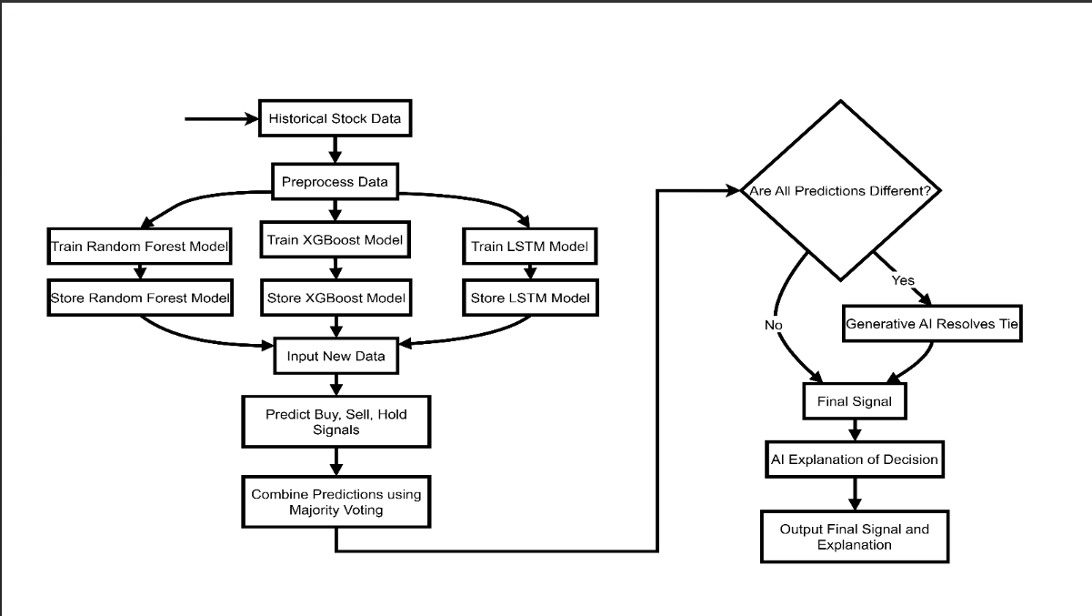
ML SIGNAL GENERATION ENGINE

Slide 8

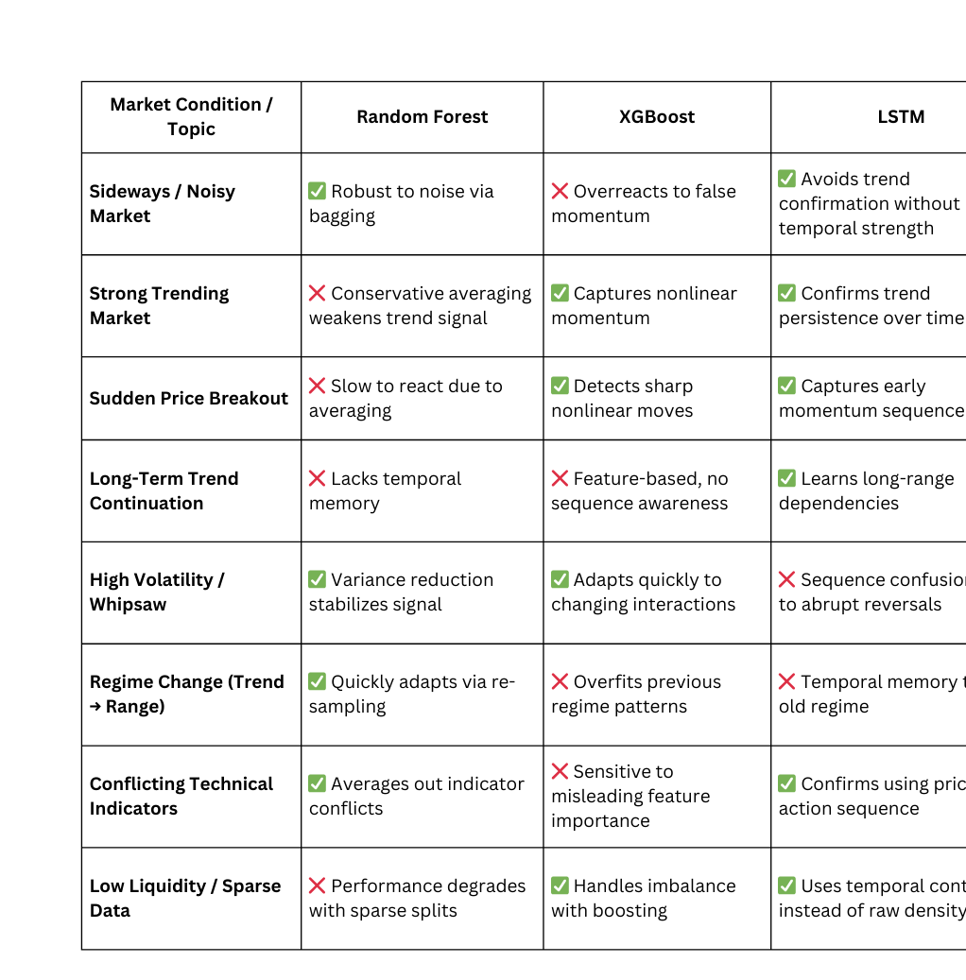
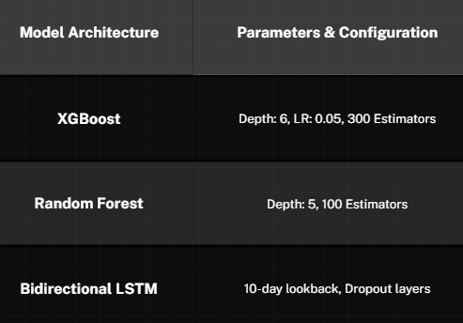
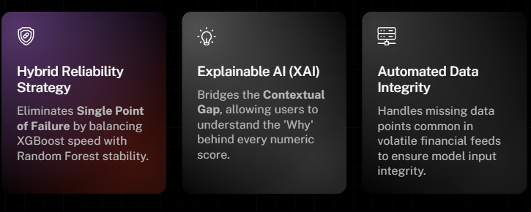
ML Models

Slide 9
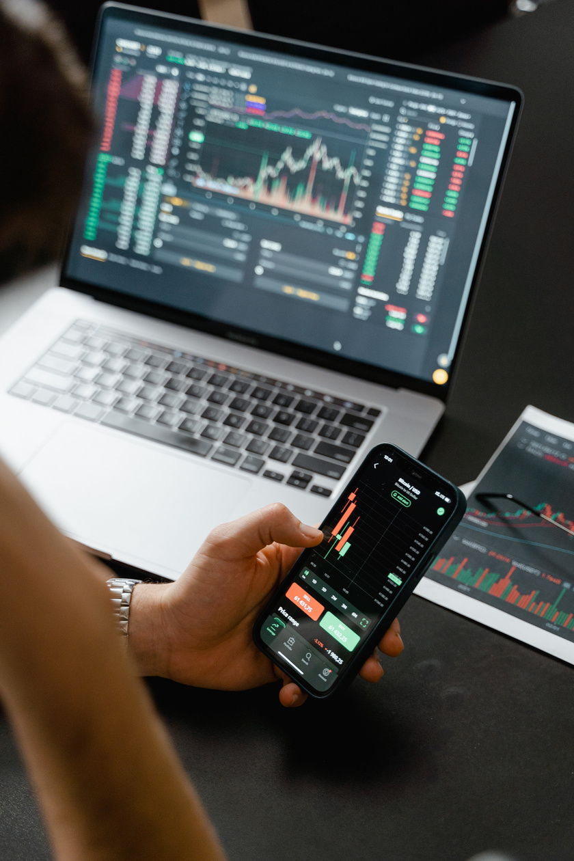


GenAI: Translating Quantitative Logic
1.ML Score Input
Meric scores and headlines are fed into the LLM synthesis engine
Top Evidence Headlines extracted from sources for verification
2.LLM Processing
Mistral and llama3 categorize the data into high confidence market vibes
Clear Sentiment Categories providing instant visibility into market posture
3.StrategOutput
Plain English reasoning with an evidence based auidit trail
Detailed Reasoning Narratives that explain the logic behind every signal

Slide 10

What is
Backtesting?
Applying a trading strategy to historical market data to see how it would have performed
It is the validation and evaluation layer of the platform
Its objective is to test ML-generated trading signals on historical market data and determine whether those signals are profitable, stable, and risk-aware
“High ML accuracy does not guarantee profits. Backtesting ensures strategies are financially viable and risk-aware before deployment“

Slide 11
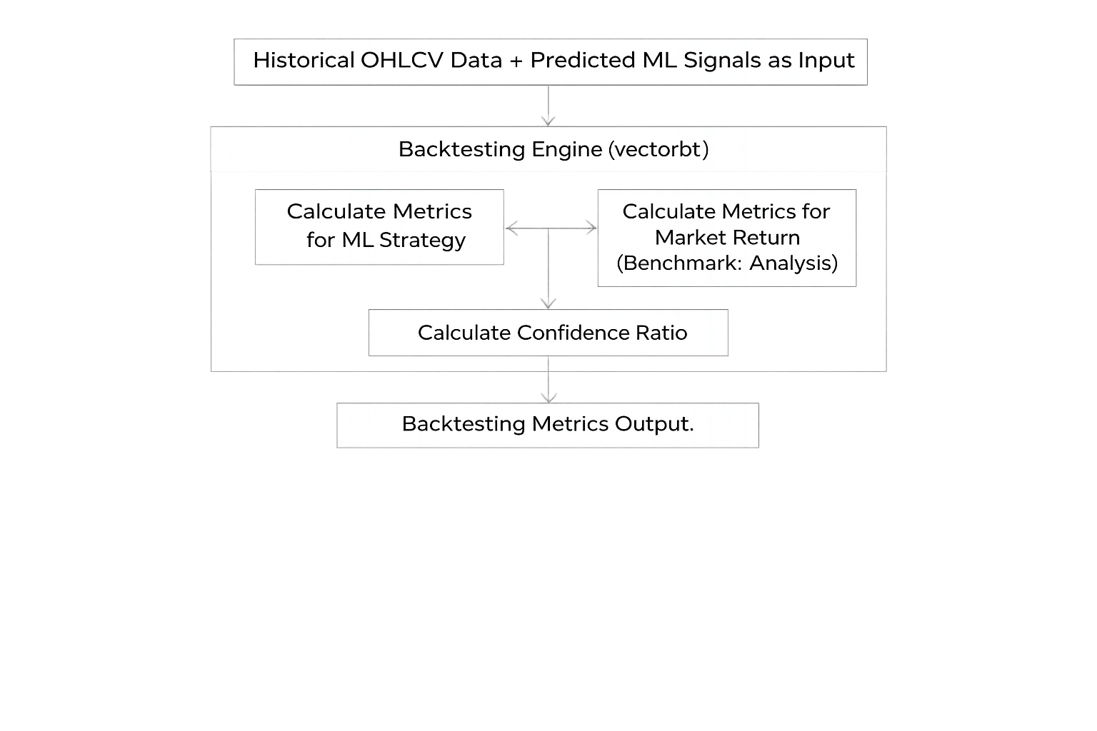
Flow Chart
Historical OHLCV data along with predicted ML signals are given as input
The engine runs the trading strategies against the historical timeline using Vectorbt
This step simulates account balance, transaction costs, and trade execution as if they were happening in real-time
Metrics are calculated for both ML strategy and Market return
Confidence ratio is calculated using metrics and sent to dashboard
This provides validation to the predicted signals and enhances user trust

Slide 12
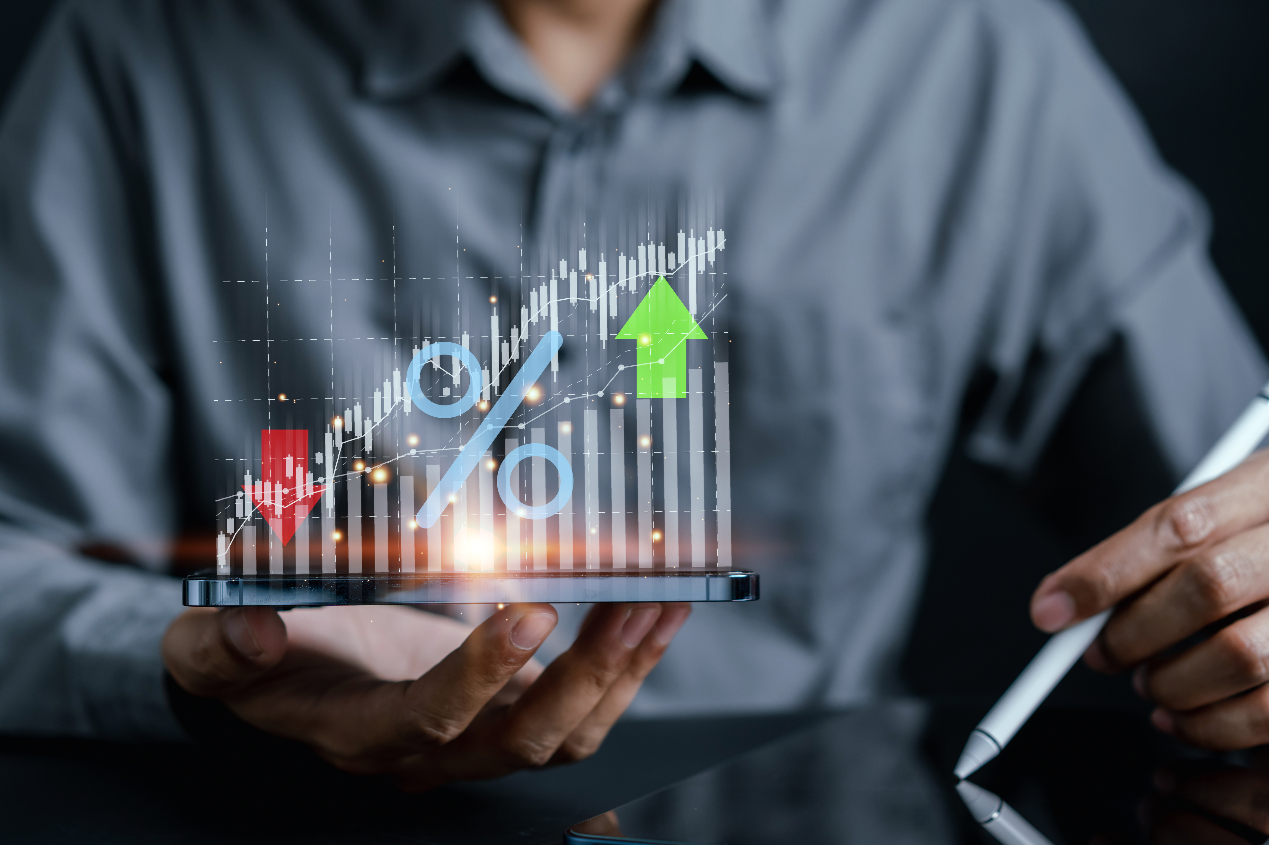
Outputs
The system generates the following key outputs
Total Return
CAGR
Volatility
Sharpe Ratio
Max Drawdown
Win Rate
Profit Factor
Market Benchmark Metrics (Buy & Hold)
Confidence Score
Equity Curve & Trade Statistics
“Only validated, confidence-backed, and risk-aware signals are shown to users and used for alerts”

Slide 13
Real-Time Alerts System
The Alerts Service is responsible for notifying users when a strong and reliable BUY or SELL signal is detected for a stock
Since raw ML signals can be noisy and risky, this service ensures that alerts are sent only when the ML signal is validated using historical performance and meets a confidence threshold
User configures alert preferences via dashboard by providing ticker, email, timeframe
Notifications are delivered via email for the selected ticker in given timeframe

Slide 14
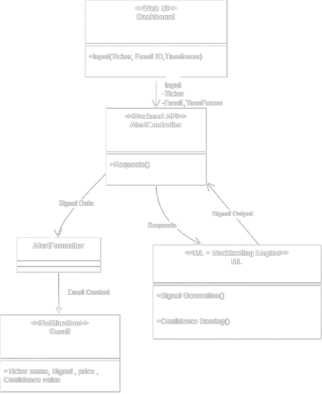
Flowchart
The user provides ticker, email ID and timeframe and registers for alerts via dashboard
The alert controller automatically runs the alert pipeline during the specified timeframe
The pipeline triggers ML and backtesting API to predict the signal and validate it
Upon validation the following Alert Content is sent via email
- Ticker symbol
- Signal type
- Current price
- Confidence score

Slide 15
What is
Dashboard & Visualization Hub?
It is the user-friendly interface of the AI-Powered Stock & ETF Signal Generation Platform that acts as the final presentation layer, converting complex ML, data engineering, and backtesting outputs into clear and actionable visual insights.
The dashboard ensures transparency and informed decision-making by visually presenting BUY/SELL/HOLD signals, confidence scores, technical indicators, and performance metrics in a professional trading interface.
“Even accurate ML models are ineffective if users cannot interpret or trust their outputs. The dashboard ensures transparency, clarity, and informed decision-making.”

Slide 16

Flow Chart
AI-generated trading signal and confidence score are fetched
Cleaned historical and real-time market data is loaded
Technical indicators and price charts are rendered
User selects a stock or ETF
All visual components, metrics, and alerts are displayed
Backtesting performance data is retrieved
User analyzes insights and makes trading decisions
• Shows end-to-end user interaction with the dashboard
• Data is loaded automatically from backend APIs
• AI signals and confidence are visualized, not calculated here
• Technical indicators support signal understanding

Slide 17
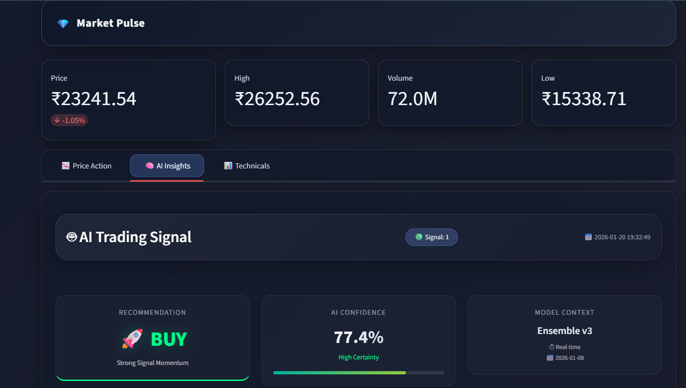
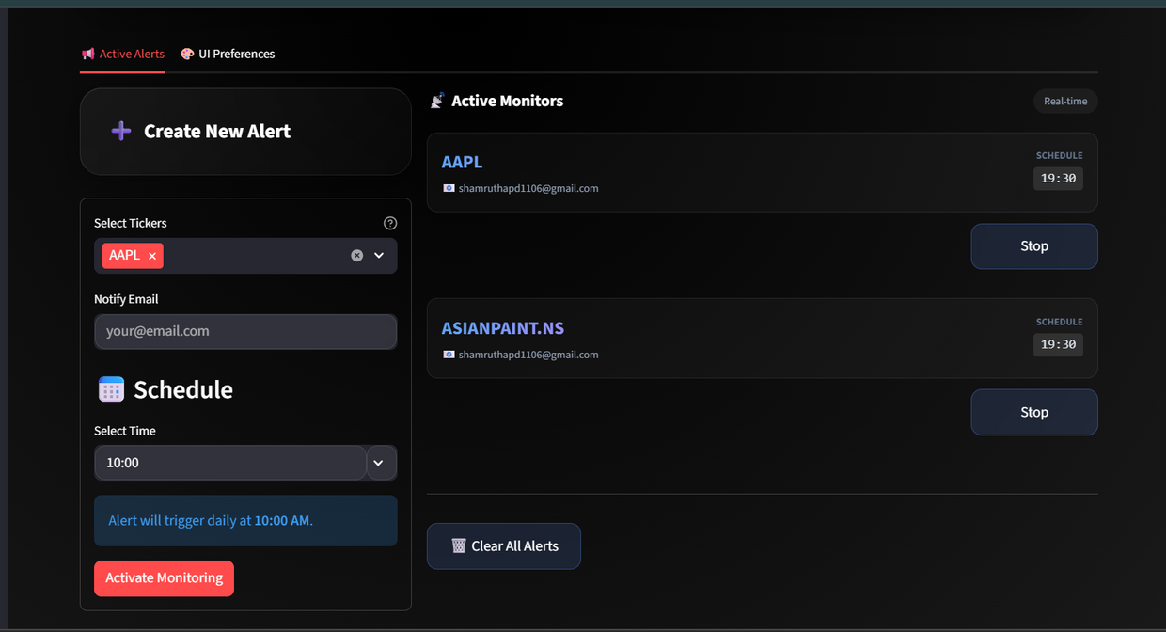

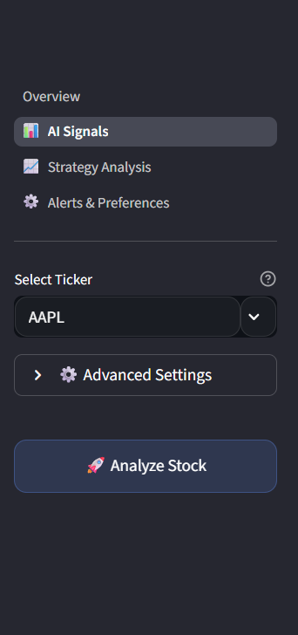
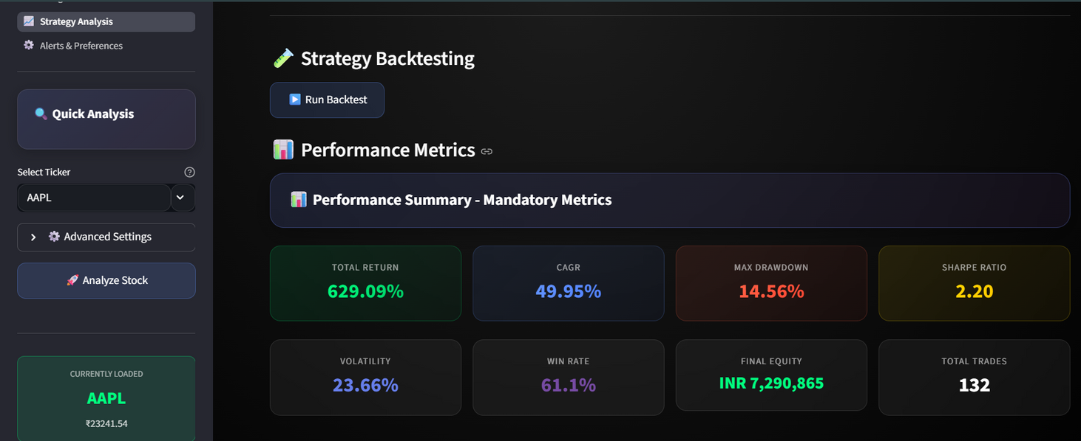
Alerts and notification
Schedhuled Alerts
Price Action
Set Alerts
Ai Insights
Pick Alert Time
AI Suggestion
Sidebar
performance metrics
run button
Sidebar Pages
Analyze stock
All Tickers

Slide 18

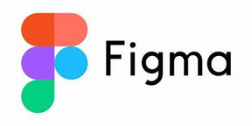
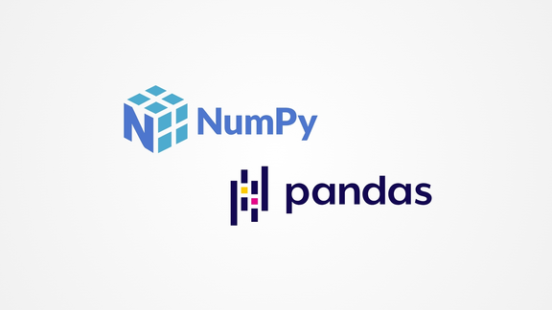

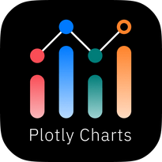
Dashboard System Output & Tools Used
Dashboard System Output & Data Presentation
• Selected ticker symbol
• AI-generated signal (BUY / SELL / HOLD)
• Current market price
• Confidence score
• Risk & volatility indicators
• Backtesting performance summary
• Data is fetched via APIs
• Data can be exported for reporting
Tools Used
• Streamlit – UI development
• Plotly – interactive charts
• Python – backend logic
• Pandas & NumPy – data handling
• Figma – UI design planning

